Slide 1
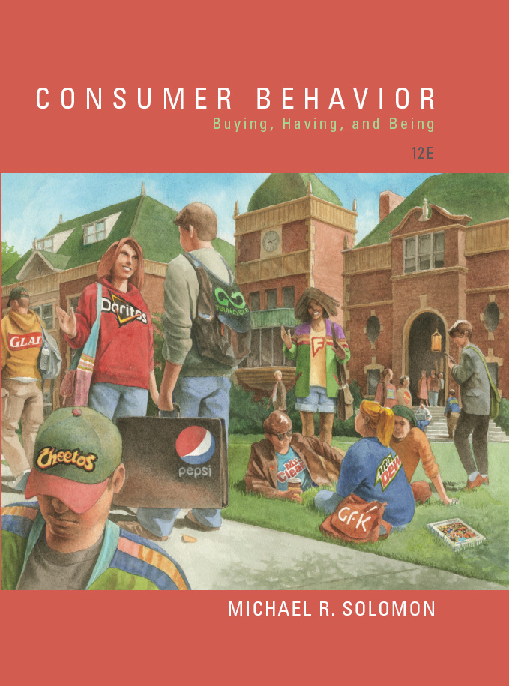
Consumer Behavior: Buying, Having, and Being
Twelfth Edition
Chapter 5
Motivation and Affect
Copyright © 2017, 2015, 2013 Pearson Education, Inc. All Rights Reserved.
Notes:
If this PowerPoint presentation contains mathematical equations, you may need to check that your computer has the following installed:
1) MathType Plugin
2) Math Player (free versions available)
3) NVDA Reader (free versions available)
This chapter defines the scope of international business and introduces us to some of its most important topics.

Slide 2
Learning Objectives
5.1 Products can satisfy a range of consumer needs.
5.2 Consumers experience different kinds of motivational conflicts that can impact their purchase decisions.
5.3 Consumers experience a range of affective responses to products and marketing messages.
5.4 The way we evaluate and choose a product depends on our degree of involvement with the product, the marketing message, or the purchase situation.

Slide 3
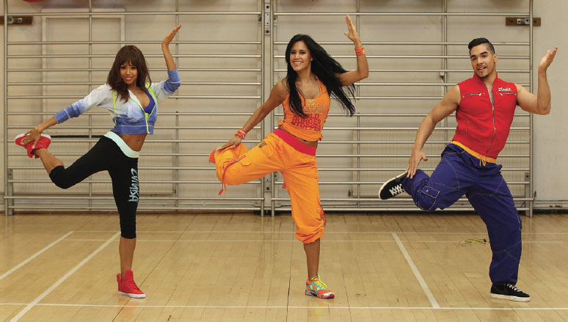
Learning Objective 5.1
Products can satisfy a range of consumer needs.

Slide 4
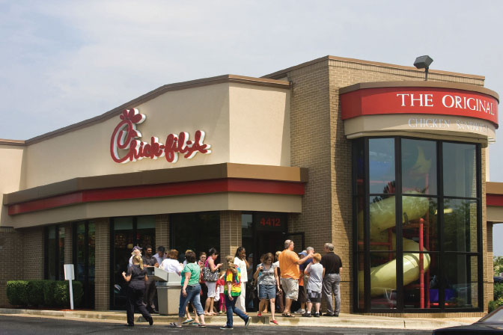
The Motivation Process: Why Ask Why?
Motivation
Utilitarian
Hedonic
Goal
Incidental brand exposure
Notes:
Motivation refers to the processes that lead people to behave as they do. It occurs when a need is aroused that the consumer wishes to satisfy. The need creates a state of
tension that drives the consumer to attempt to reduce or eliminate it. This need may be utilitarian (i.e., a desire to achieve some functional or practical benefit, as when a person
loads up on green vegetables for nutritional reasons) or it may be hedonic (i.e., an experiential need, involving emotional responses or fantasies as when a person feels “righteous” by
eating kale). The desired end state is the consumer’s goal.
incidental brand exposure:
●● People who were exposed to a sign in a room of the brand name “Apple” provided
responses on an unrelated task that were more unique compared to those who saw a
sign with the IBM brand name.
●● College students who used a “cute” ice cream scoop to help themselves to ice cream
took a larger amount than those who used a plain scoop; the researchers explained
that the whimsical object drove them to be more self-indulgent even though they
weren’t aware of this effect.
●● Some students scored higher on difficult Graduate Records Examination questions
when they took the test using a Massachusetts Institute of Technology pen and delivered
a better athletic performance when they drank water from a Gatorade cup during
strenuous exercise.

Slide 5
Motivational Strength
Drive Theory
Homeostasis
Retail Therapy
Expectancy Theory
Notes:
Drive theory focuses on biological needs that produce unpleasant states of arousal (e.g., your stomach grumbles during a morning class). The arousal this tension causes motivates
us to reduce it and return to a balanced state called homeostasis. Some researchers believe that this need to reduce arousal is a basic mechanism that governs much of
our behavior. Indeed there is research evidence for the effectiveness of so-called retail therapy; apparently the act of shopping restores a sense of personal control over one’s
environment and as a result can alleviate feelings of sadness. Go for it!

Slide 6

Motivational Direction
Needs Versus Wants
Productivity orientation
Notes:
Productivity orientation refers to a continual striving to use time constructively: Trying new things is a way to check them off our “bucket list” of experiences we want to achieve before we move on to others.

Slide 7
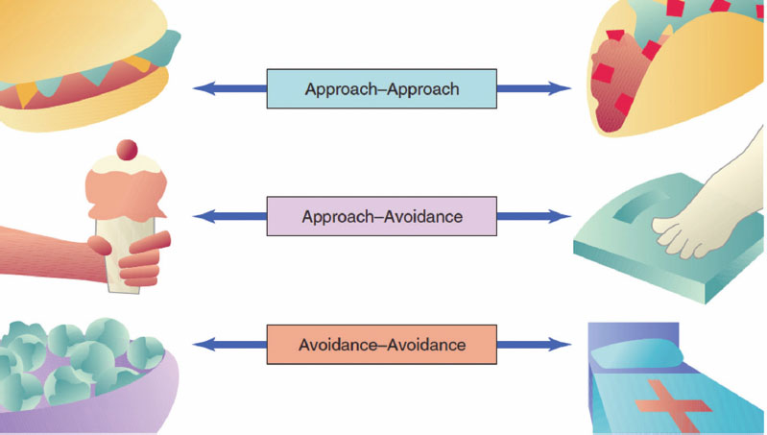
Motivational Conflicts
Notes:
A person has an approach–approach conflict when he or she must choose between two desirable alternatives. A student might be torn between going home for the holidays and
going on a skiing trip with friends. Or, he or she might have to choose between two CDs to download (assuming that he or she is going to pay for one of them!). The theory of cognitive
dissonance is based on the premise that people have a need for order and consistency in their lives and that a state of dissonance (tension) exists when beliefs or behaviors
conflict with one another.
An approach–avoidance conflict occurs when we desire a goal but wish to avoid it at the same time.

Slide 8
Classifying Consumer Needs
Murray’s psychogenic needs
Autonomy, defendence, play
Specific needs
Need for Affiliation
Need for Power
Need for Uniqueness
Notes:
One such inventory that the psychologist Henry Murray developed delineates a set of 20 psychogenic needs that (sometimes in combination) result in specific behaviors. These needs
include such dimensions as autonomy (being independent), defendance (defending the self against criticism), and even play (engaging in pleasurable activities).
Need for affiliation (to be in the company of other people): The need for affiliation is relevant to products and services for people in groups, such as participating in team
sports, frequenting bars, and hanging out at shopping malls.
Need for power (to control one’s environment):17 Many products and services allow us to feel that we have mastery over our surroundings. These products range from
“hopped-up” muscle cars and loud boom boxes (oversized portable radios that impose one’s musical tastes on others) to luxury resorts that promise to respond to every
whim of their pampered guests.
Need for uniqueness (to assert one’s individual identity): Products satisfy the need for uniqueness when they pledge to bring out our distinctive qualities. For example,
Cachet perfume claims to be “as individual as you are.”

Slide 9
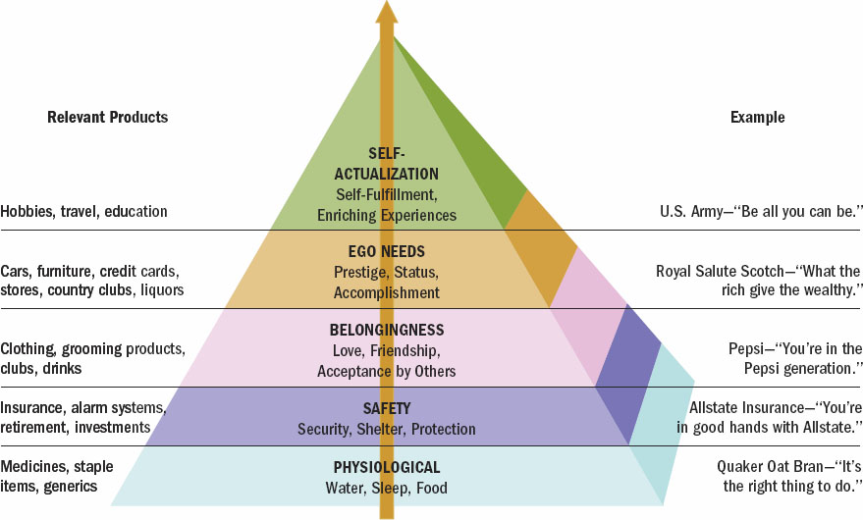
Figure 5.2: Maslow’s Hierarchy of Needs

Slide 10
For Reflection (1 of 3)
Give an example when you had a need for affiliation, power, or uniqueness.

Slide 11
Learning Objective 5.2
Consumers experience different kinds of motivational conflicts that can impact their purchase decisions.

Slide 12
Types of Affective Responses
Evaluations
Moods
Emotions
Negative State relief
Sadvertising
Emotional Oracle effect
Mood Congruency
Notes:
Evaluations are valenced (i.e., positive or negative) reactions to events and objects that are not accompanied by high levels of physiological arousal. For example, when a consumers evaluates a movie as being positive or negative, this usually involves some degree of affect accompanied by low levels of arousal (possible exceptions such as Fifty Shades of Gray notwithstanding!). Moods involve temporary positive or negative affective states accompanied by moderate levels of arousal. Moods tends to be diffuse and not necessarily linked to a
particular event (e.g. you might have just “woken up on the wrong side of the bed this morning”). Emotions such as happiness, anger, and fear tend to be more intense and
often relate to a specific triggering event such as receiving an awesome gift.
Helping others as a way to resolve one’s own negative moods is known as negative state relief. Recently we’ve seen a trend in advertising toward inspirational stories that manipulate our emotions like a rollercoaster: Think about the commercials Budweiser likes to run about a puppy who befriends a horse, gets lost, finds his way home, etc. This practice even has a name: sadvertising.
Interplay between our emotions and how we access information in our minds that allows us to make smarter decisions is called an emotional oracle effect
Mood congruency refers to the idea that our judgments tend to be shaped by our moods.

Slide 13

Positive Affect
Lovemark
Happiness
Material accumulation
Notes:
Lovemark is a passionate commitment to one bran.
Happiness is a mental state of well-being characterized by positive emotions.
Material accumulation, which is what researchers term the instinct to earn more than we can possibly consume, even when this imbalance makes us unhappy.

Slide 14
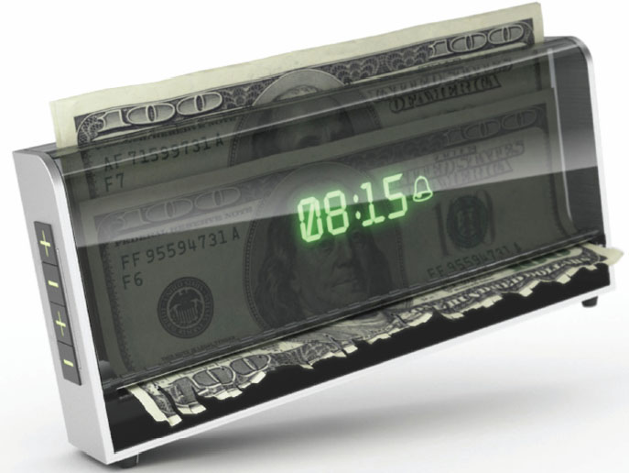
Negative Affect
Disgust
Envy
Guilt
Embarrasment

Slide 15
How Social Media Tap into Our Emotions
Happiness economy
Sentiment analysis
Word-phrase dictionary
Notes:
Proponents of a happiness economy claim that wellbeing is the new wealth, and social media technology is what allows us to accumulate it
A technique called sentiment analysis refers to a process (sometimes also called opinion mining) that scours the social media universe to collect and analyze the words people use when they describe a specific product or company. When people feel a particular way, they are likely to choose certain words that tend to relate to the emotion. From these words, the researcher creates a wordphrase dictionary (sometimes called a library) to code the data. The program scans the text to identify whether the words in the dictionary appear.

Slide 16
For Reflection (2 of 4)
Give an example of when a product had a negative or positive affect on you.

Slide 17
Learning Objective 5.3
Consumers experience a range of affective responses to products and marketing examples.

Slide 18
Learning Objective 5.4
The way we evaluate and choose a product depends on our degree of involvement with the product, the marketing message, or the purchase situation.

Slide 19

Consumer Involvement
Involvement
Inertia
Cult products
Notes:
Involvement is “a person’s perceived relevance of the object based on their inherent needs, values, and interests.”
Inertia describes consumption at the low end of involvement, where we make decisions out of habit because we lack the motivation to consider alternatives.
Cult products such as Apple—or Hydrox, Harley-Davidson, Jones Soda, Chick-Fil-A, Manolo Blahnik designer shoes (think Carrie on Sex and the City), and the Boston Red
Sox—command fierce consumer loyalty, devotion, and maybe even worship by consumers. A large majority of consumers agree that they are willing to pay more for a brand
when they feel a personal connection to the company.

Slide 20
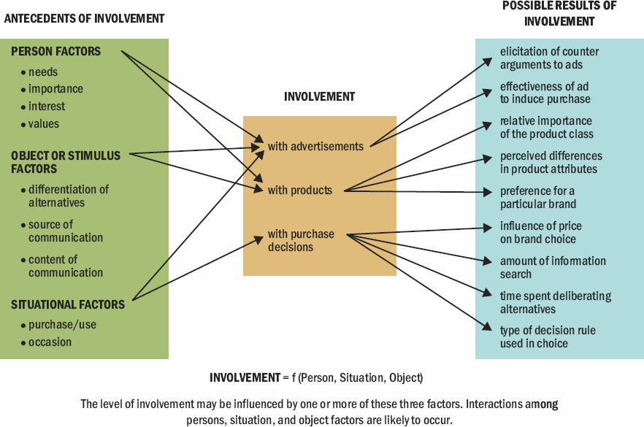
Figure 5.2 Conceptualizing Involvement
Notes:
Before we explore the three types of decision-making, we need to first ask why different consumers may approach the same choice situation from very different perspectives. One reason is the consumer’s level of involvement in the decision. Involvement is a person’s perceived relevance of the object based on their inherent needs, values, and interests. We use the term object in the generic sense to refer to a product, brand, ad, or purchase situation. Figure 2.2 illustrates how we can conceptualize the construct of involvement in terms of its antecedents and possible results.

Slide 21
Measuring Involvement
Table 5.1 A Scale to Measure Involvement
To Me [Object to Be Judged] Is
Important | _:_:_:_:_:_:_ | unimportant*
2. boring | _:_:_:_:_:_:_ | Interesting
3. relevant | _:_:_:_:_:_:_ | irrelevant*
4. exciting | _:_:_:_:_:_:_ | unexciting*
5. means nothing | _:_:_:_:_:_:_ | means a lot to me
6. appealing | _:_:_:_:_:_:_ | unappealing*
7. fascinating | _:_:_:_:_:_:_ | mundane*
8. worthless | _:_:_:_:_:_:_ | valuable
9. involving | _:_:_:_:_:_:_ | uninvolving*
10. not needed | _:_:_:_:_:_:_ | needed
Notes:
Table 5.1 illustrates a scale that consumer researchers can use to measure involvement.

Slide 22
Types of Involvement
Product
Message
Situational
Notes:
Product involvement is a consumer’s level of interest in a particular product. As a rule, product decisions are likely to be highly involving if the consumer believes there is perceived risk.
Message involvement refers to the influence media vehicles have on the consumers. Print is a high-involvement medium while television tends to be considered a low-involvement medium.
Situational involvement takes place with a store, website, or a location where people consume a product or service. One way to increase this kind of involvement is to personalize the messages shoppers receive at the time of purchase.

Slide 23
Product Involvement
Perceived risk
Mass customization
Brand loyalty
Variety seeking
Notes:
Product involvement is a consumer’s level of interest in a particular product. The more closely marketers can tie a brand to an individual, the higher the involvement they will create.
As a rule, product decisions are likely to be highly involving if the consumer believes there is a lot of perceived risk. This means the person believes there may be negative
consequences if he or she chooses the wrong option.
Mass customization describes the personalization of products and services for individual customers at a mass-production price.
Brand loyalty: Repeat purchasing behavior that reflects a conscious decision to continue buying the same brand.
Variety-seeking, the desire to choose new alternatives over more familiar ones, even influences us to switch from our favorite products to ones we like less!

Slide 24
Five Types of Perceived Risk
Monetary risk
Functional risk
Physical risk
Social risk
Psychological risk
Notes:
Monetary risk occurs when making a poor choice will have a monetary consequence. Any purchase that costs a lot is subject to this risk. Functional risk is the risk that the product may not function as the consumer needs. Physical risk is the risk that the choice may physically threaten the consumer. Social risk is the risk that the choice will reflect poorly on the consumer and damage his or her self-esteem or confidence. Psychological risk is the risk that one may lose self-respect due to making a bad decision. For instance, expensive luxury goods could cause the consumer to feel extensive guilt.

Slide 25
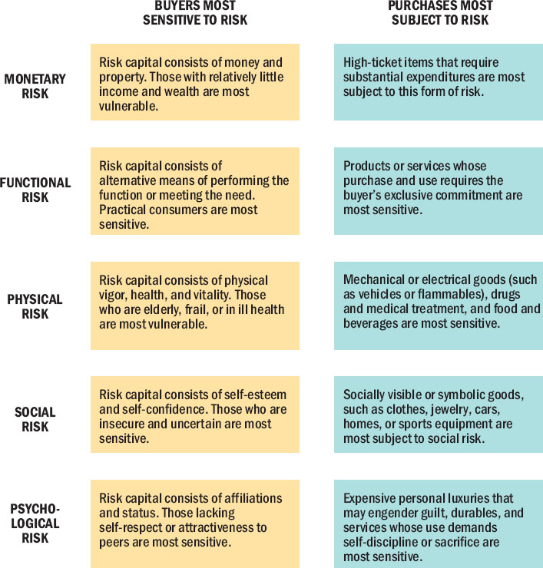
Figure 5.4 Five Types of Perceived Risk
Notes:
This figure illustrates the five types of risk along with purchases that are likely to be associated with each form of risk. Monetary risk is associated with high-ticket items like a car purchase. Functional risk is associated with products that must perform in order to satisfy. Pharmaceutical products are an example of product choices associated with physical risk. Symbolic goods tend to be associated with social risk. Personal luxuries can be associated with psychological risks.

Slide 26

Message Involvement
Alternate reality games
Narrative transportation
Notes:
Alternate reality games (ARGs), thousands of people participate in a fictional story or competition to solve a mystery.
Print is a high-involvement medium (whether it appears on a “dead tree” or in an e-book). The reader actively processes the information and (if desired) he or she is
able to pause and reflect on it before turning the page.68 In contrast, television is a low involvement medium because it requires a passive viewer who exerts relatively little control
(remote-control “zipping” notwithstanding) over content.
Narrative transportation, where people become immersed in the storyline.

Slide 27
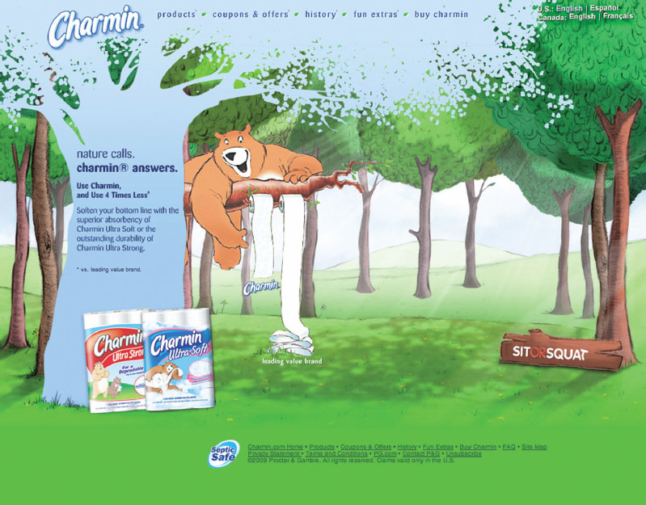
Charmin Leverages Product and Situational Involvement
Notes:
Charmin frequently sponsors clean toilet facilities at major events, recognizing that product and situational involvement can overlap.

Slide 28
For Reflection (3 of 4)
What risky products have you considered recently?
Which forms of risk were involved?
Notes:
Consider purchases you’ve made that reflect the five kinds of risk.

Slide 29
For Reflection (4 of 4)
Have you ever been immersed into an advertisement that you feel like you are part of it?

Slide 30
For Review
Products can satisfy a range of consumer needs.
Consumers experience different kinds of motivational conflicts that can impact their purchase decisions.
Consumers experience a range of affective responses to products and marketing messages.
The way we evaluate and choose a product depends on our degree of involvement with the product, the marketing message, or the purchase situation.

Slide 31

Copyright

